Slide 1
VIETNAMESE TEXT CLASSIFICATION
HO CHI MINH CITY UNIVERSITY OF TECHNOLOGY (HCMUT)
Candidate: Nguyễn Hoàng Dũng
DIVE INTO CODE - MACHINE LEARNING COURSE - GRADUATION ASSIGNMENT

Slide 2
TABLE OF CONTENTS
01
INTRODUCTION
02
ML PROCESS
03
EVALUATION
04
CONSIDERATION
TABLE OF CONTENTS
What is text classification? Its approaches?
From data understanding, preprocessing, and modelling
Is the work do well? What metrics to be used?
Is this machine learning algorithm effective for this data?
1

Slide 3
TEXT CLASSIFICATION
01 - INTRODUCTION
Text classification is a task that assigns a set of predefined categories to open-ended text.
2

Slide 4
Due to the categories, we can divide text classification into smaller subtasks.
01 - INTRODUCTION
Sub-task | Categories
Spam detection | [‘Spam’, ‘Not Spam’]
Intent detection | [‘Has intent’, ‘No intent’]
Sentiment analysis | [‘Like’, ‘Dislike’, ‘Neutral’]
Topic labeling | [‘Sports’, ‘Business’, ‘Travel’, ‘Culture’, ‘Tech’,...]
3

Slide 5
TEXT CLASSIFICATION APPROACHES
RULE-BASED
ML-BASED
HYBRID
01 - INTRODUCTION
Use a set of handcrafted linguistic rules.
Let the machine learns to make classifications based on labeled samples.
Combine ML-based with rule-based to improve the results
4

Slide 6
WHAT MY ASSIGNMENT APPLIED?
01 - INTRODUCTION
SUBTASK | APPROACH | LANGUAGE
Spam detection | Rule-based | Vietnamese
Sentiment analysis | ML-based | English
Topic modeling | Hybrid | Other
5

Slide 7

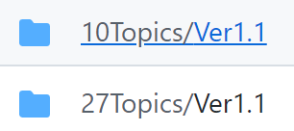
DATASET
02 - ML PROCESS
From the paper: A Comparative Study on Vietnamese Text Classification Methods
Link: https://github.com/duyvuleo/VNTC
2 types of labeling
6

Slide 8
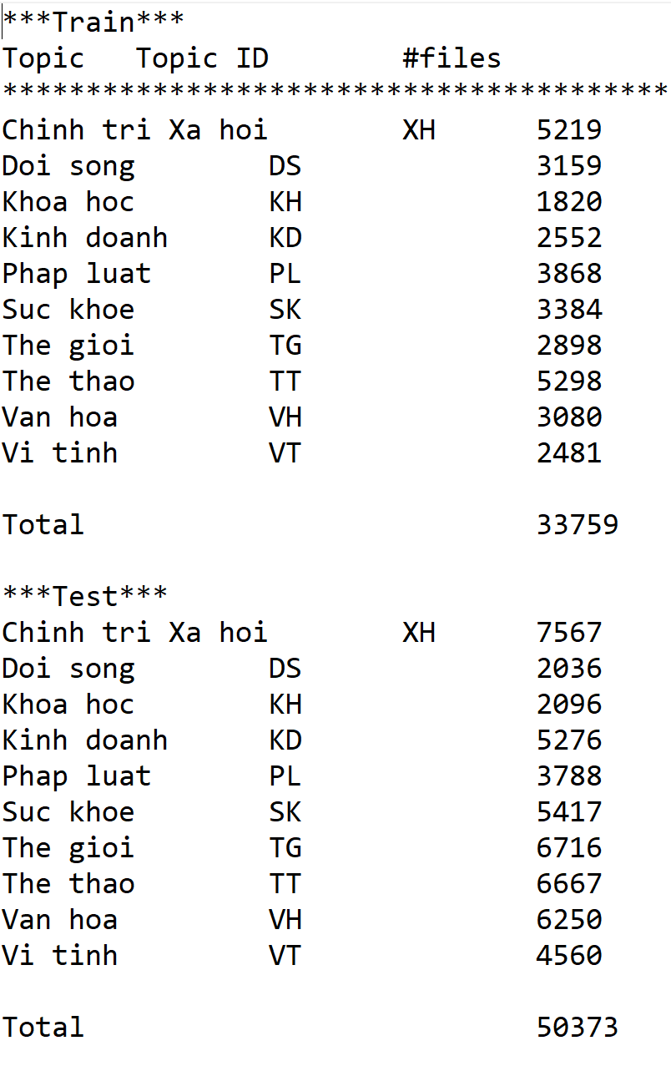
DATASET
02 - ML PROCESS
STATISTICS
Training set: 33579 samples
Test set: 50373 samples
7

Slide 9
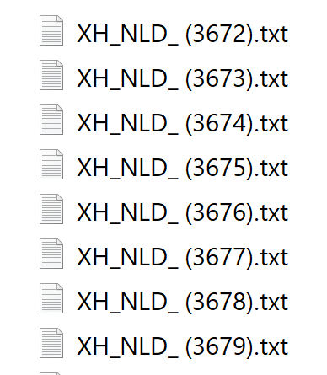
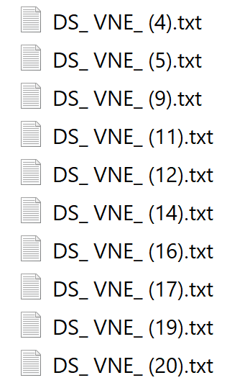
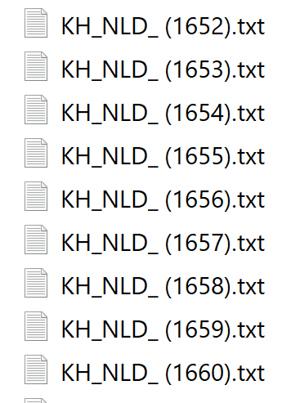
DATA PREPARATION
02 - ML PROCESS
Converting all the files (in .txt) to 2 .csv files.
(Code shown in: csv_generation.ipynb)
8

Slide 10
DATA PREPROCESSING
02 - ML PROCESS
TEXT
NORMALIZATION
WORD SEGMENTATION
& TOKENIZATION
ID CONVERT & SEQUENCE PADDING
9

Slide 11
DATA PREPROCESSING
WORD SEGMENTATION
02 - ML PROCESS
Perform stripping, lowercase and remove unwanted symbols.
“ Thành lập dự án POLICY phòng chống HIV/AIDS ở VN (NLĐ)- Quỹ hỗ trợ khẩn cấp về AIDS của Hoa Kỳ vừa thành lập dự án POLICY tại VN… “
“thành lập dự án policy phòng chống hiv aids ở vn nlđ quỹ hỗ trợ khẩn cấp về aids của hoa kỳ vừa thành lập dự án policy tại vn“
10

Slide 12
DATA PREPROCESSING
WORD SEGMENTATION & TOKENIZATION
02 - ML PROCESS
Text segmentation is the process of dividing written text into meaningful units.
Why we need to do it?
In Vietnamese, a word may have it meaning changes when follow by another word.
E.g.,
Hoa = flowers, Kỳ = strange, Hoa Kỳ = U.S
11

Slide 13
DATA PREPROCESSING
WORD SEGMENTATION & TOKENIZATION
02 - ML PROCESS
“thành lập dự án policy phòng chống hiv aids ở vn nlđ quỹ hỗ trợ khẩn cấp về aids của hoa kỳ vừa thành lập dự án policy tại vn“
['thành_lập', 'dự_án', 'policy', 'phòng_chống', 'hiv', 'aids', 'ở', 'vn', 'nlđ', 'quỹ', 'hỗ_trợ', 'khẩn_cấp', 'về', 'aids', 'của', 'hoa_kỳ', 'vừa', 'thành_lập', 'dự_án', 'policy', 'tại', 'vn']
12

Slide 14
DATA PREPROCESSING
ID CONVERT & SEQUENCE PADDING
02 - ML PROCESS
['thành_lập', 'dự_án', 'policy', 'phòng_chống', 'hiv', 'aids', 'ở', 'vn', 'nlđ', 'quỹ', 'hỗ_trợ', 'khẩn_cấp', 'về', 'aids', 'của', 'hoa_kỳ', 'vừa', 'thành_lập', 'dự_án', 'policy', 'tại', 'vn']
[ 0, 763, 169, 3, 2137, 3, 3, 25, 33756, 3, 1425, 291, 2498, 28, 3, 7, 3, 164, 763, 169, 3, 35, 33756]
[ 0, 763, 169, 3, 2137, 3, 3, 25, 33756, 3, 1425, 291, 2498, 28, 3, 7, 3, 164, 763, 169, 3, 35, 33756, 0, 0, 0, 0, 0, 0, 0, 0, 0,... ]
13

Slide 15
MODELING
02 - ML PROCESS
ML-BASED MODEL
Vectorization: TF-IDF (Term Frequency - Inverse Document Frequency)
Classifier: SVM (Support Vector Machine)
DL-BASED MODEL
Vectorization: One-hot word representation
Classifier: CNN (Convolutional Neural Network)
14

Slide 16
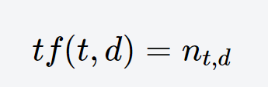
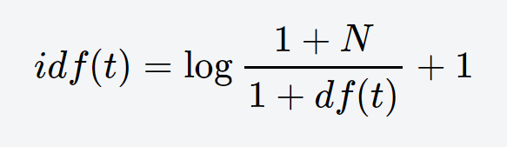
MODELING
02 - ML PROCESS
TF-IDF (scikit-learn version):
15

Slide 17
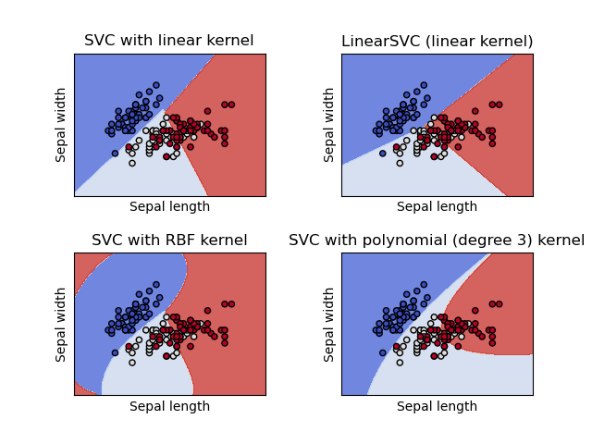
MODELING
02 - ML PROCESS
SVM (support Vector Machine):
16

Slide 18
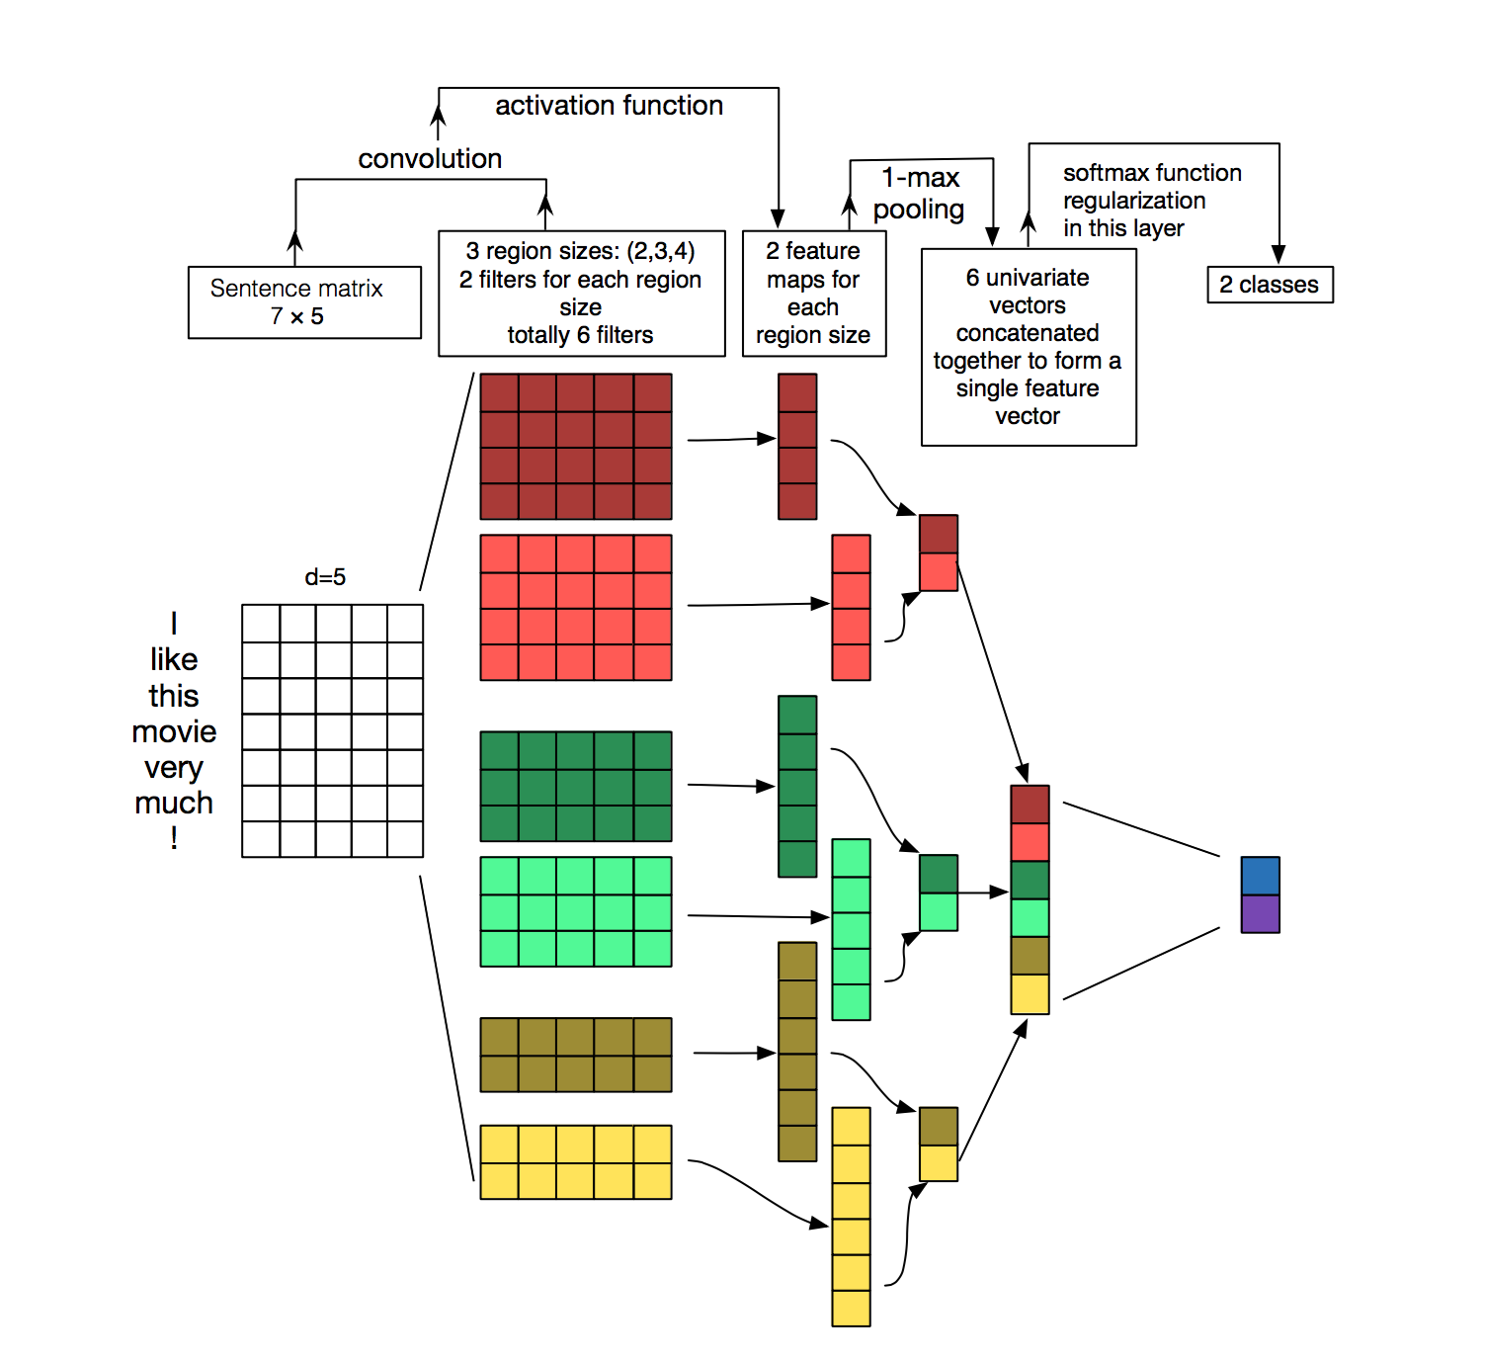
MODELING
02 - ML PROCESS
Convolutional
Neural
Network
(CNN)
17

Slide 19
MODELING
02 - ML PROCESS
Take IDs as inputs, Tensorflow will convert every tokens into a one-hot vector.
Have an Embedding layer to reduce the dimension.
Apply Conv1D layers with different filter sizes (2, 3 and 4), use ReLU activation functions, followed by GlobalMaxPool1D layers.
Concatenate the output and pass through fully-connected layers (ReLU activation functions) applied dropout regularization.
The final layer is a softmax layer.
18

Slide 20
MODELING
02 - ML PROCESS
OPTIMIZER | ADAM
LOSS | CATEGORICAL CROSS-ENTROPY
EPOCH | 20
BATCH SIZE | 32
19

Slide 21
EVALUATION METRICS
ACCURACY
PRECISION
RECALL
03 - EVALUATION
Number of correct predictions
Number of positive class predictions that actually belong to the positive class over the test set.
Number of positive class predictions made out of all positive samples.
20

Slide 22
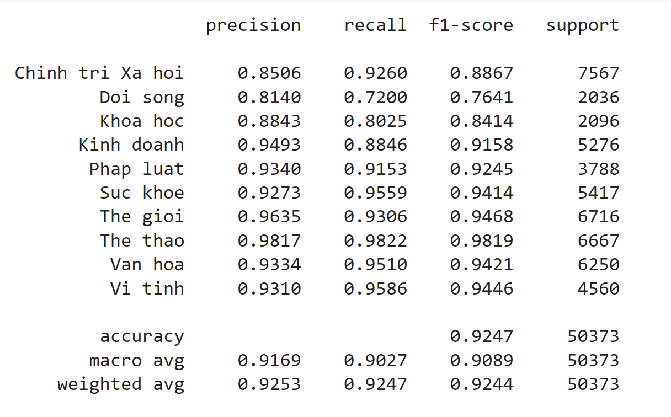
EVALUATION (SVM)
03 - EVALUATION
21

Slide 23
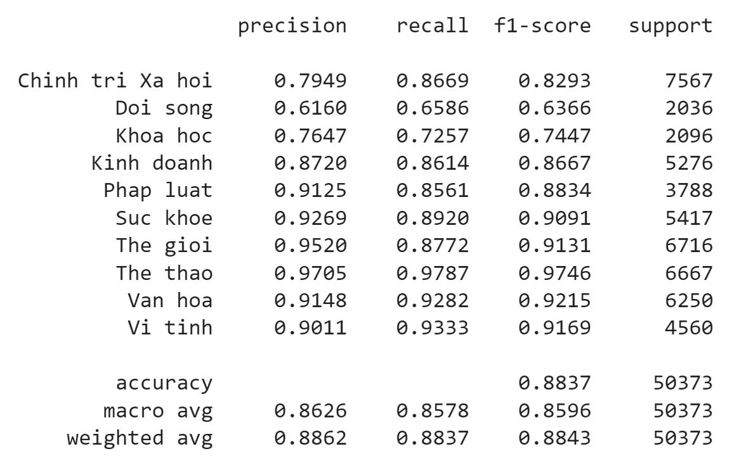
EVALUATION (CNN)
03 - EVALUATION
22

Slide 24
CONSIDERATION
04 - CONSIDERATION
0
25
50
75
100
Support Vector Machine (SVM)
92.47%
With TF-IDF vectorizer.
88.37%
Convolutional Neural Network (CNN)
Accuracy comparison of 2 models
With one-hot word representation.
23

Slide 25
THANK YOU FOR LISTENING!
Also thank our mentors for your valuable guidance in this course!
YOUR LOGO HERE
24

